Slide 1
Fostering Community and Kindness in Your Choral Program
Cate Windelborn, Monroe High School
Faith Avritt, Zach Everly, Brenna Hendrix, Maisie Hoppe, Maddy McCollum

Slide 2
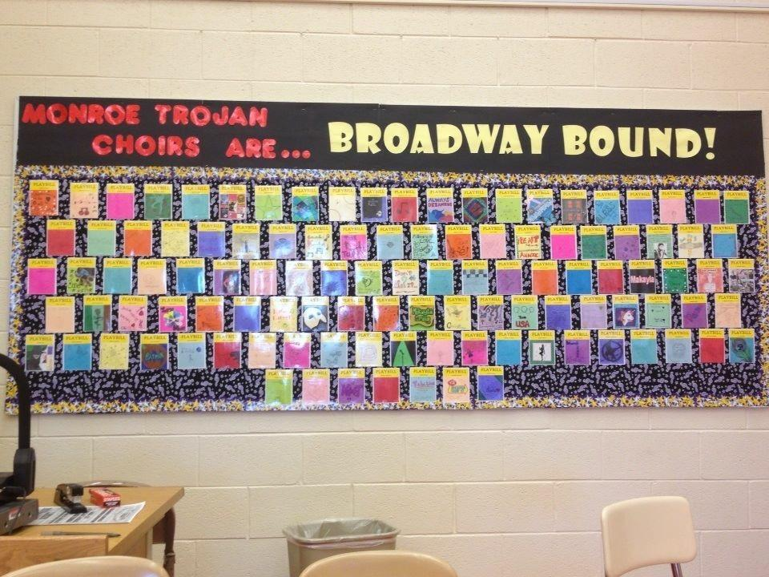
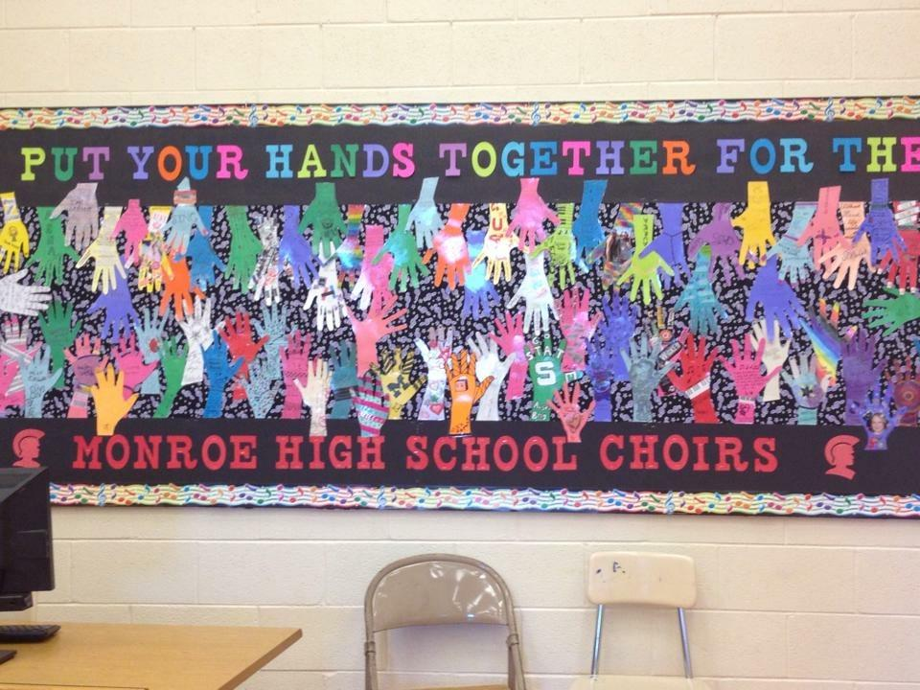
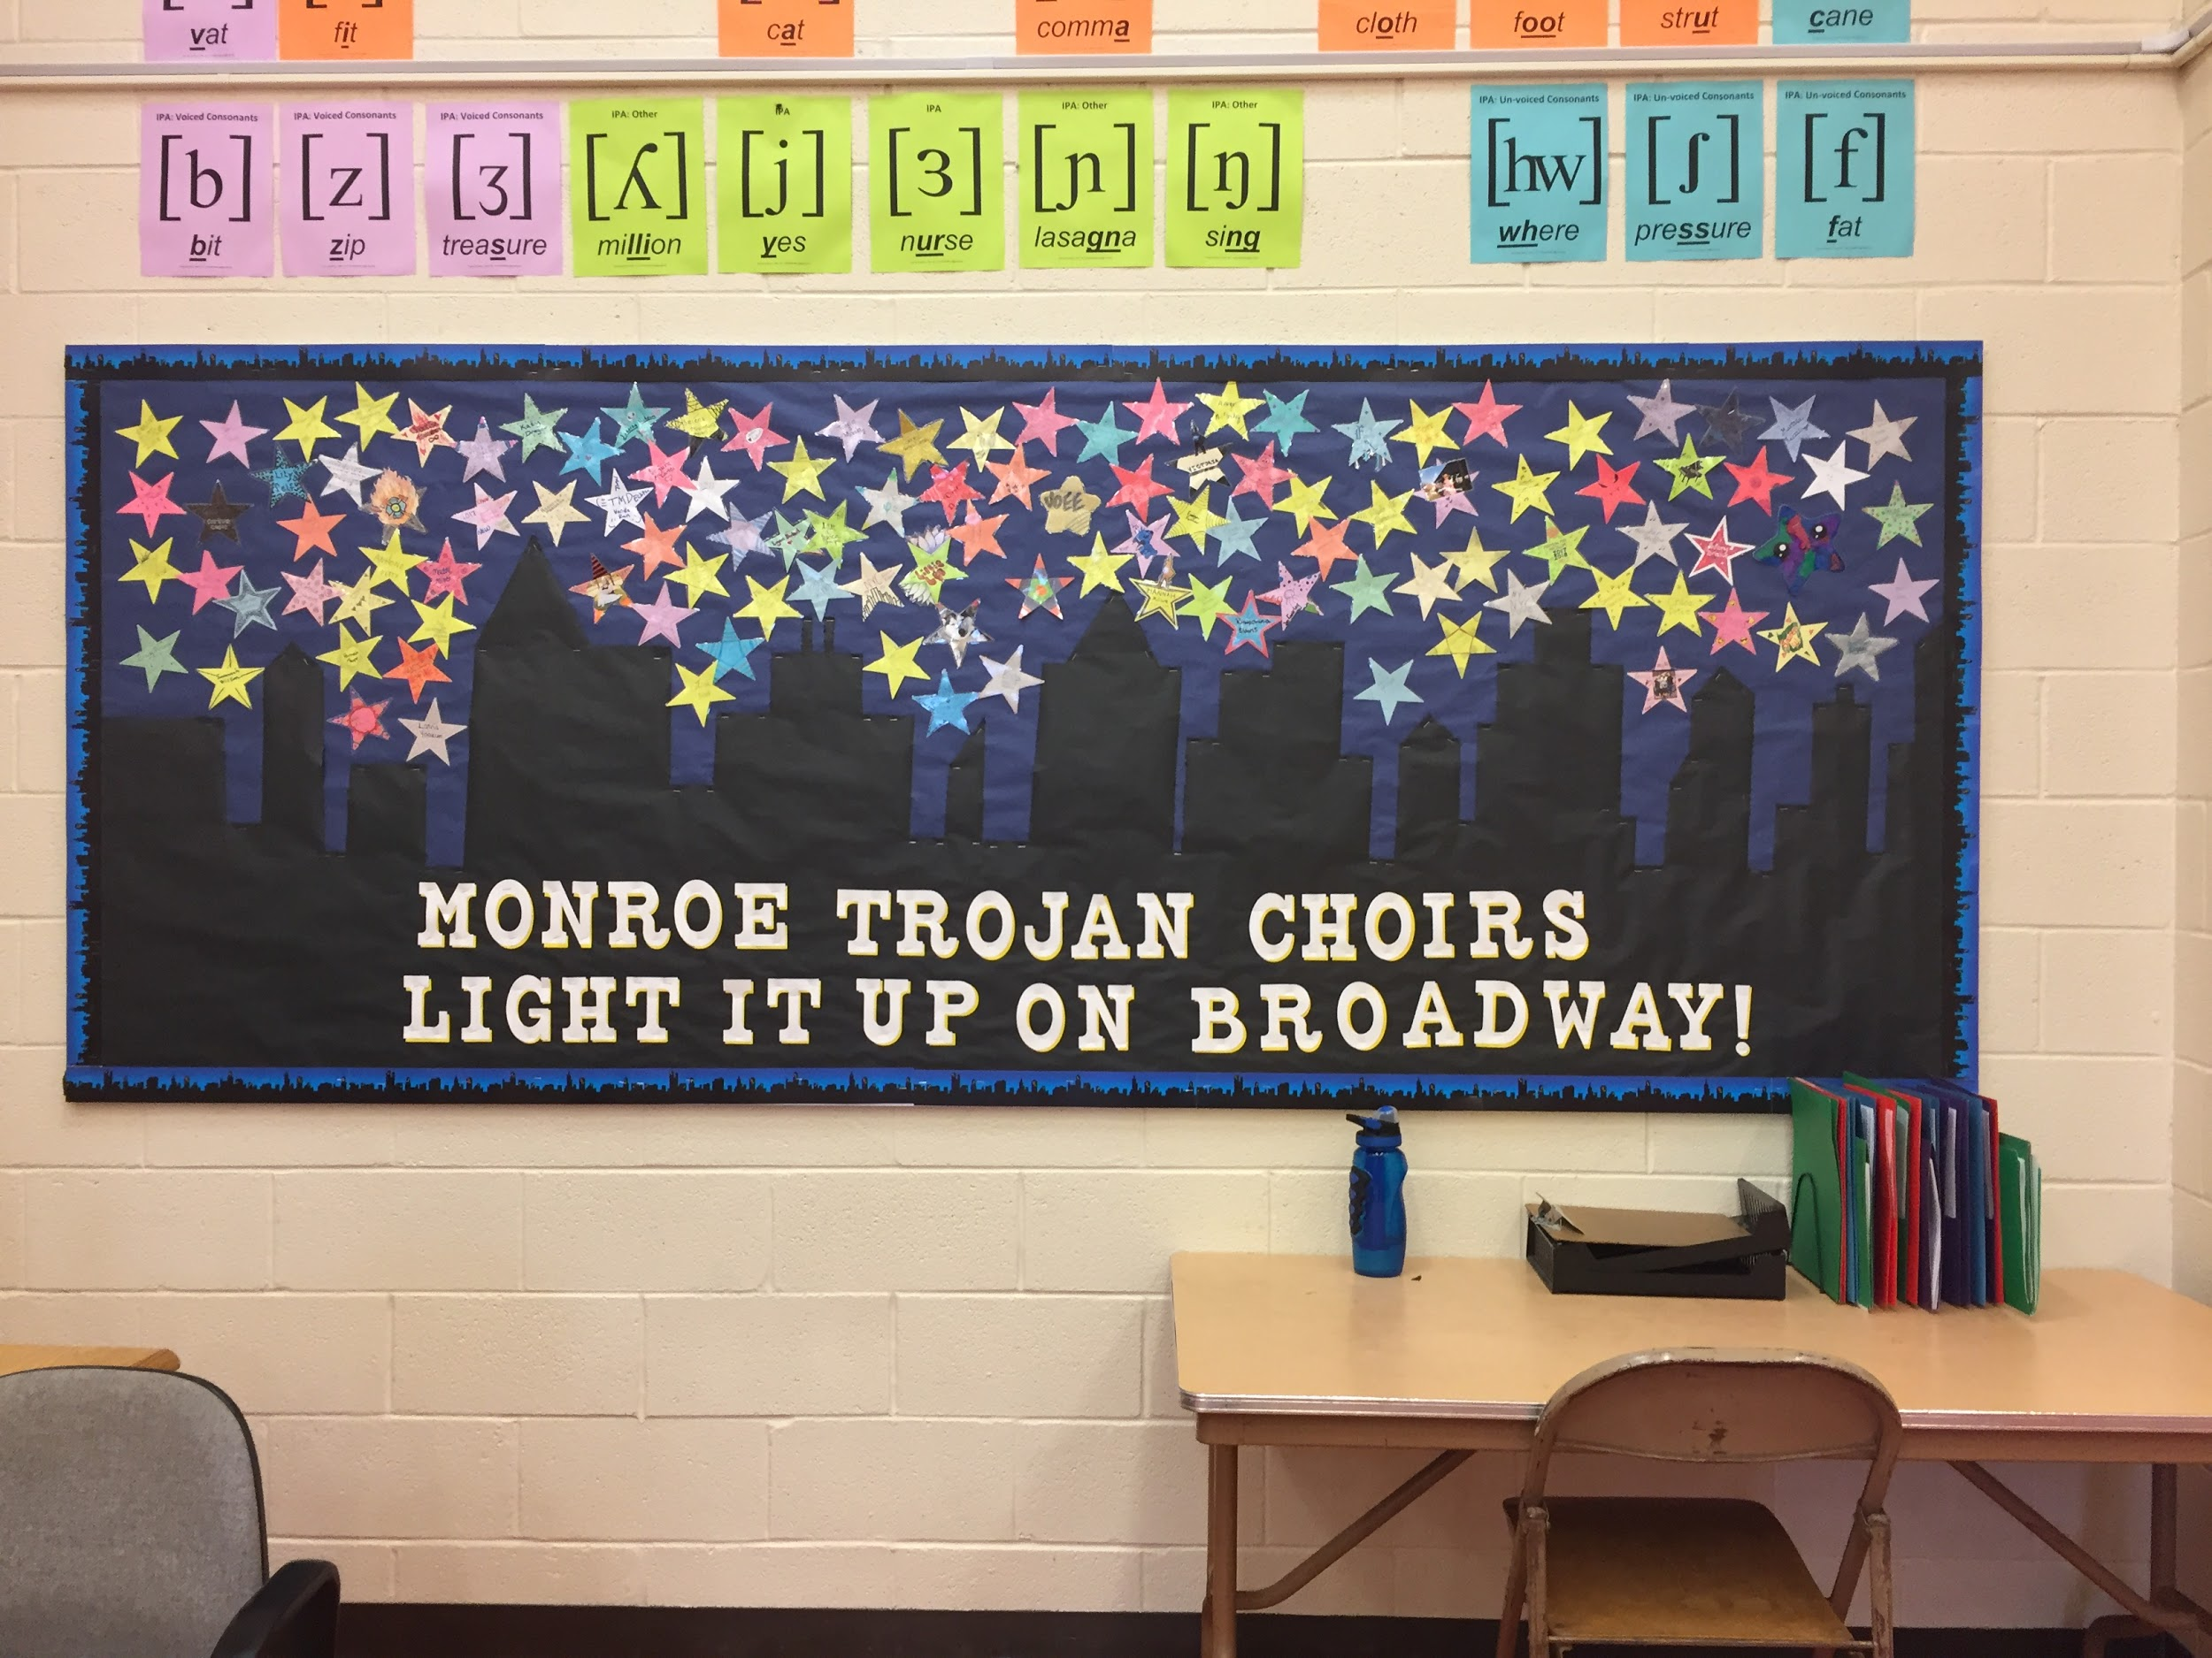
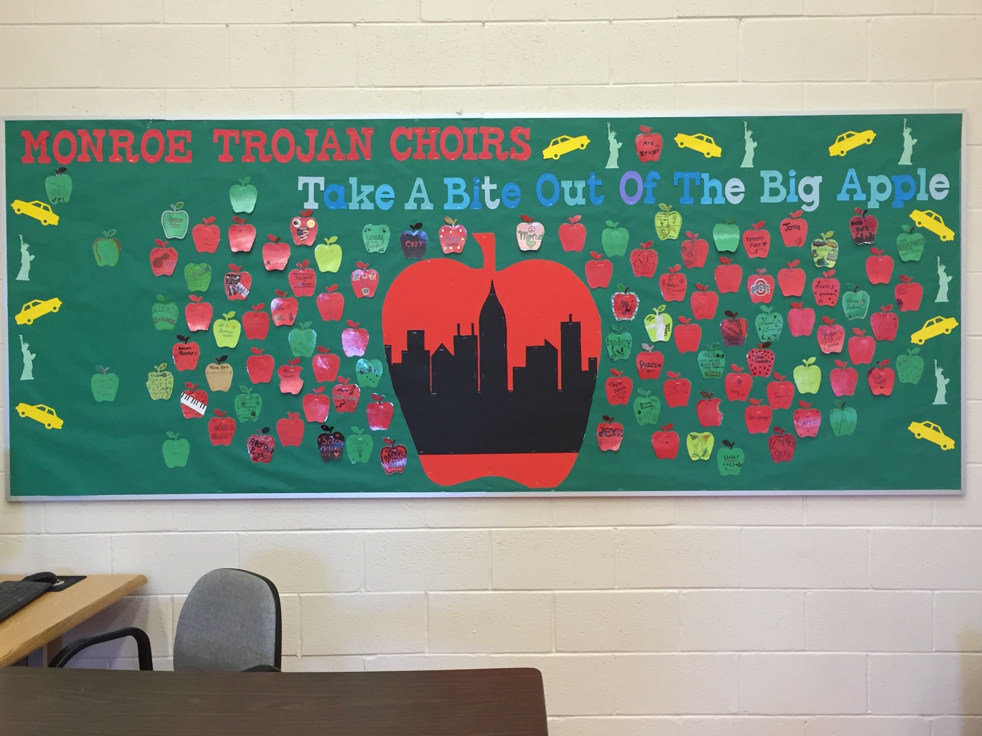
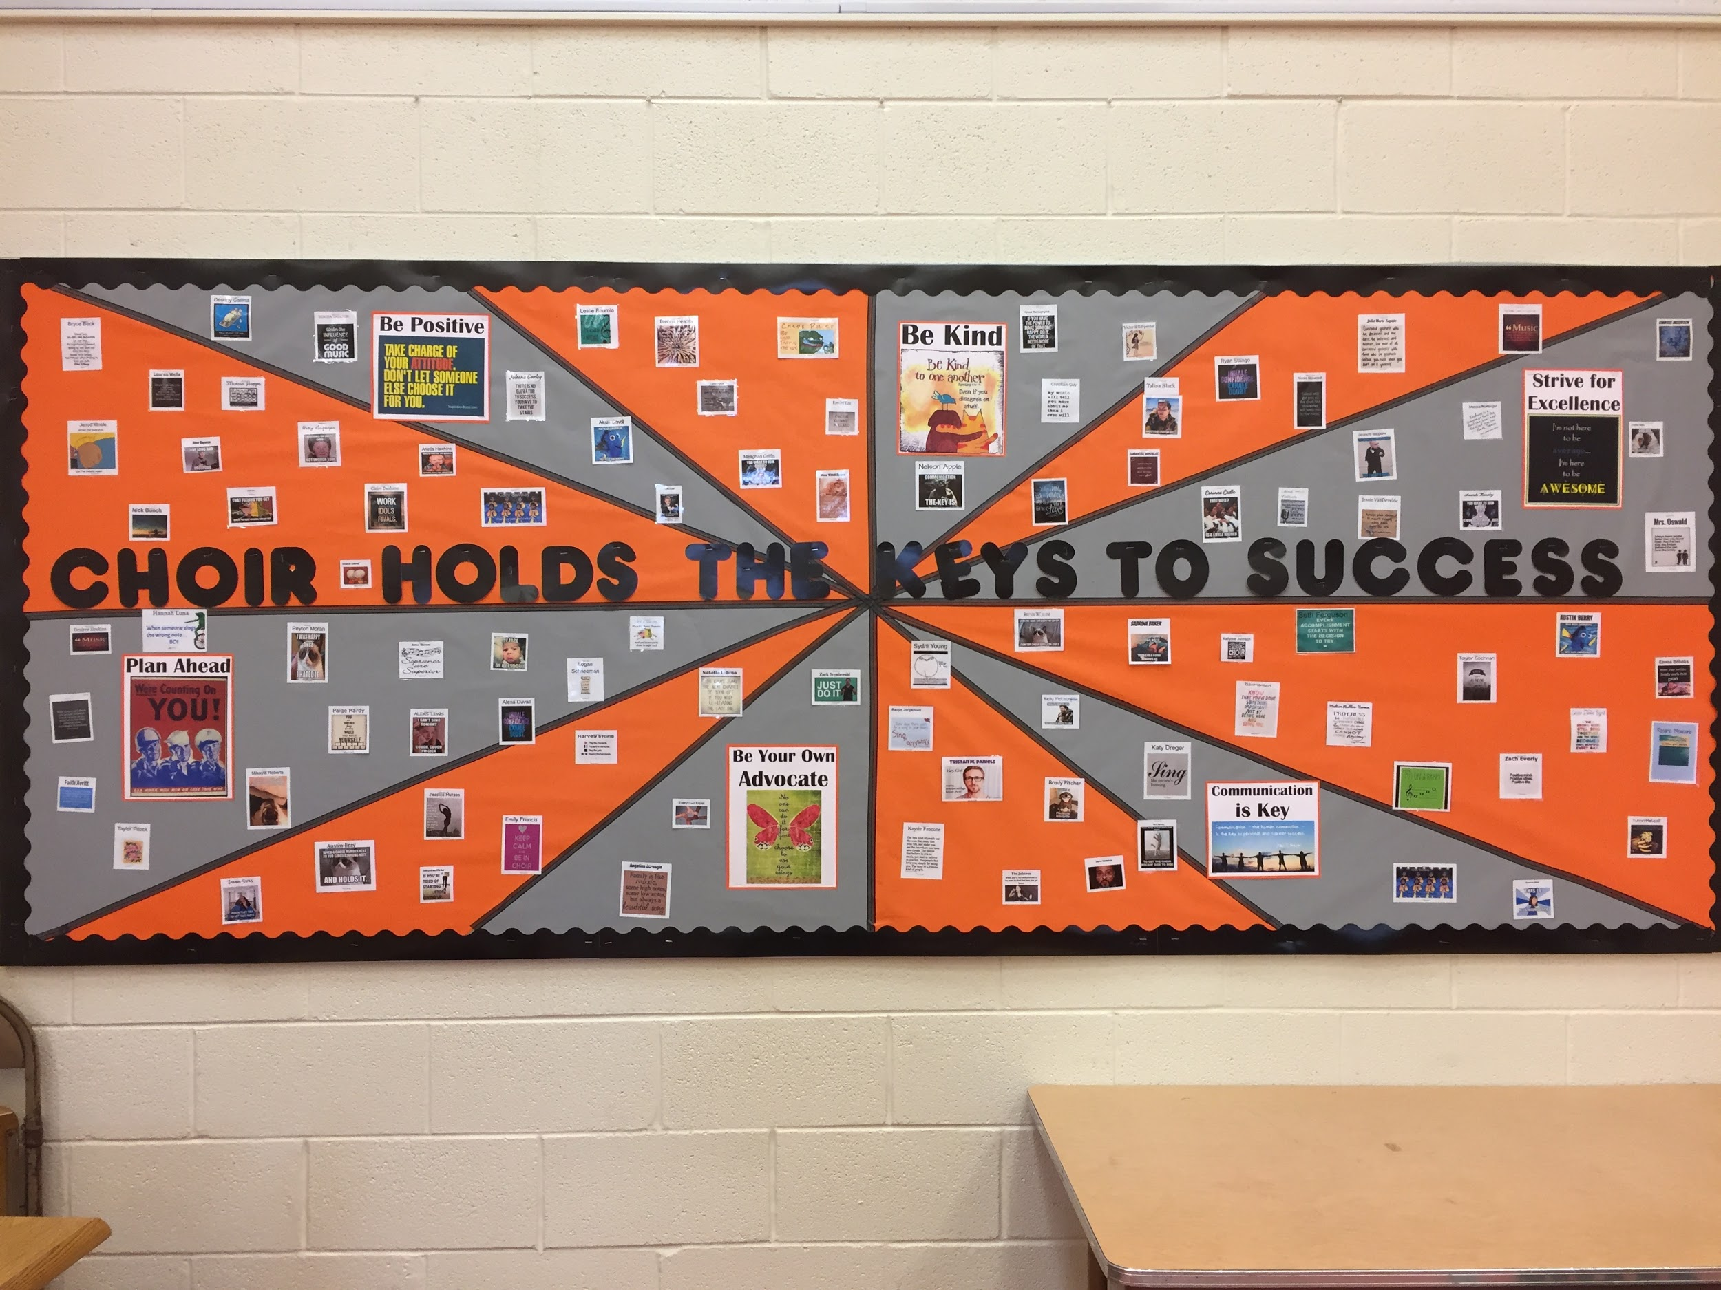
Personalized bulletin boards allow students to have something personal in our choir room, making it feel more like their own.

Slide 3
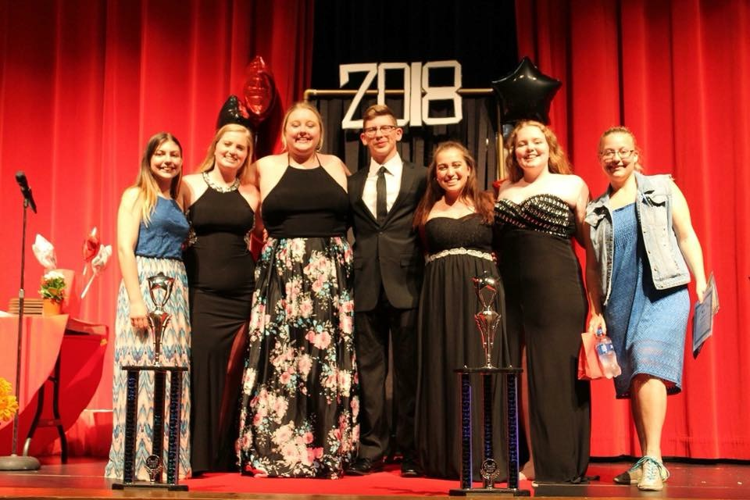
Choir Council
Multiple Council Positions
President
Vice President
Secretary
Ensemble Representative (One or Two per-ensemble)
Class Representative (One per-class)
Organize Choir Events
Karaoke Nights
Movie Nights
Concerts
Activities throughout the year

Slide 4
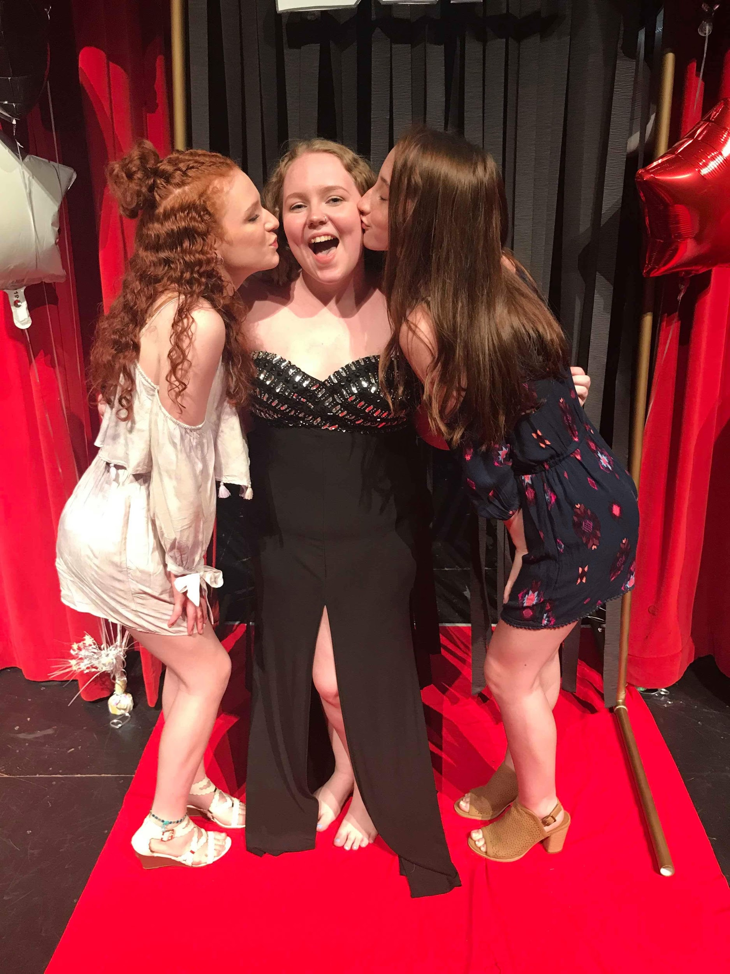
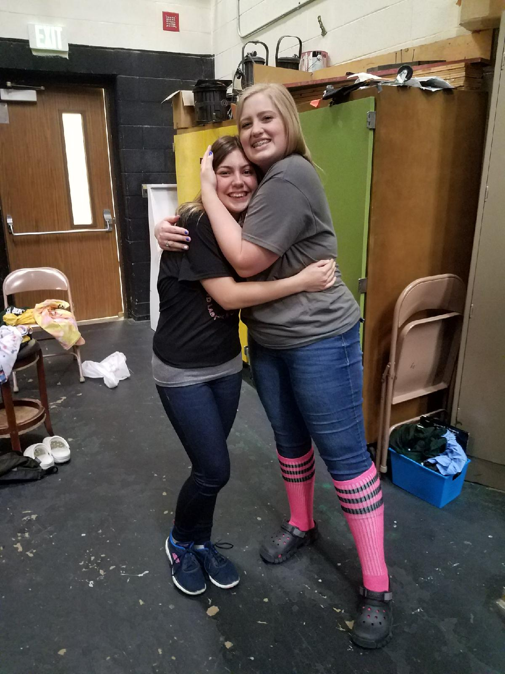
Choir Buddies
Choir Buddies are matched to be an “automatic friend” for both people.
For first year choir students, their buddy stays anonymous to them until the end of the year.
Upperclassmen aren’t required to have a choir buddy; however, some take on more than one to ensure no one is left out.
It’s a way to let new members know they always have a friend they can feel comfortable with.

Slide 5
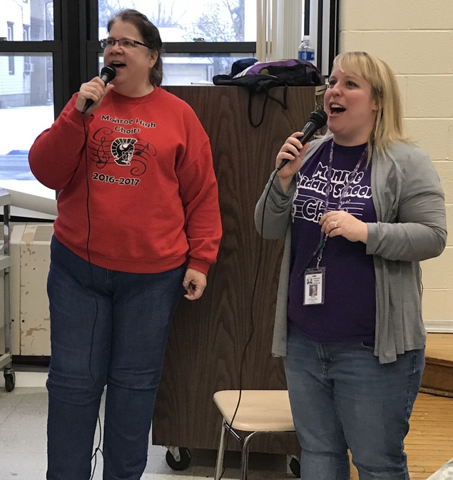
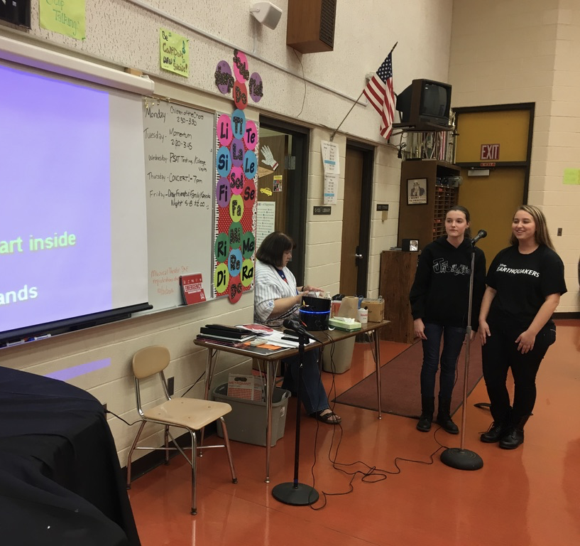
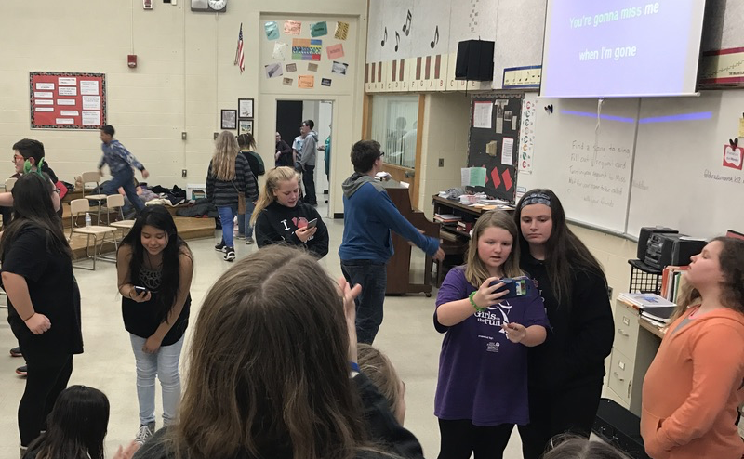
Middle-to-High School Transition
After school activities help new choir students/incoming freshmen to warm up to their new environment.
Movie night
Sit-and-Knit
Middle school karaoke night
Gives everyone a safe space where they feel they belong.
Choir camp allows freshmen to become a part of the choir family before the first day of school.
“I feel choir camp made it easier moving from middle school to high school choir because I met new people who were going to be around me all year.” -Dayonna Evans, MHS Freshman

Slide 6
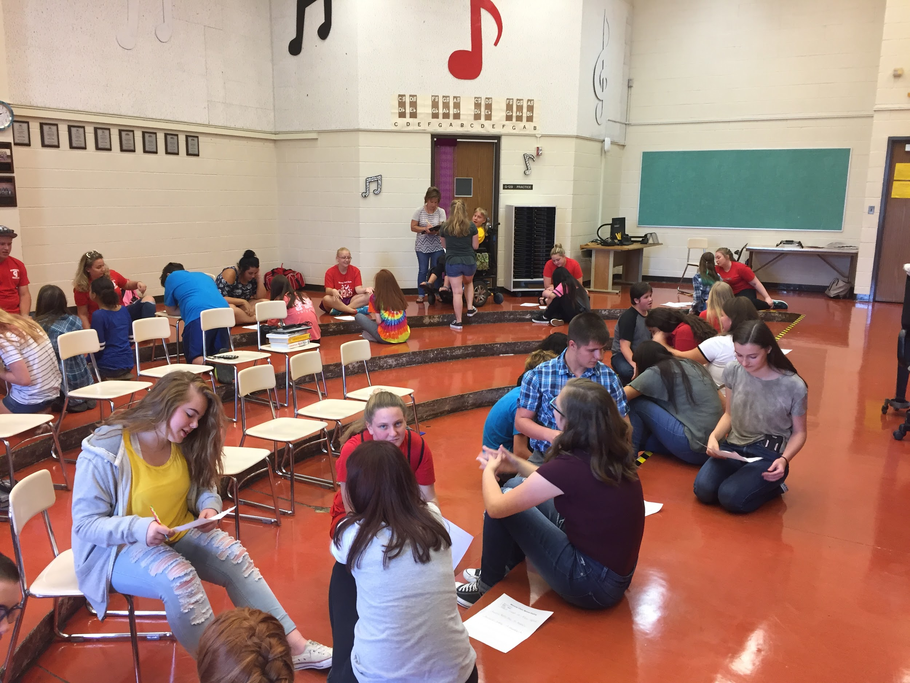
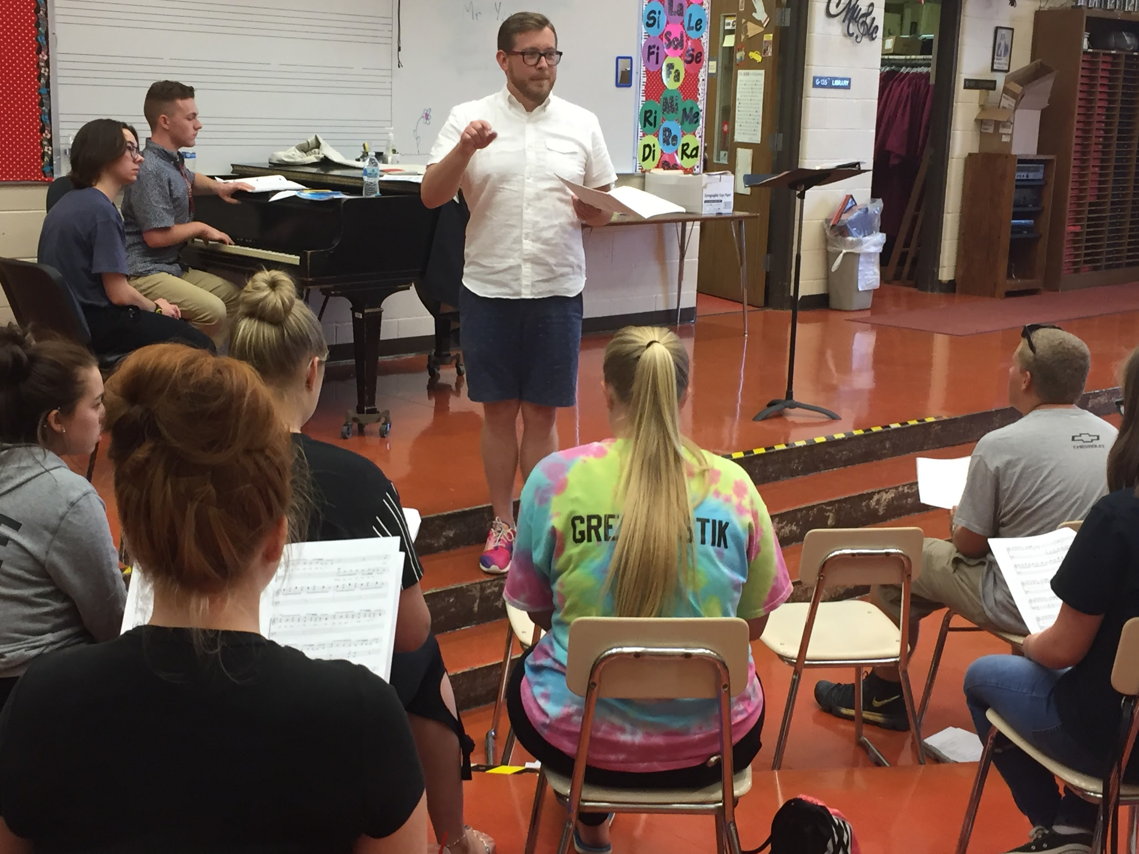
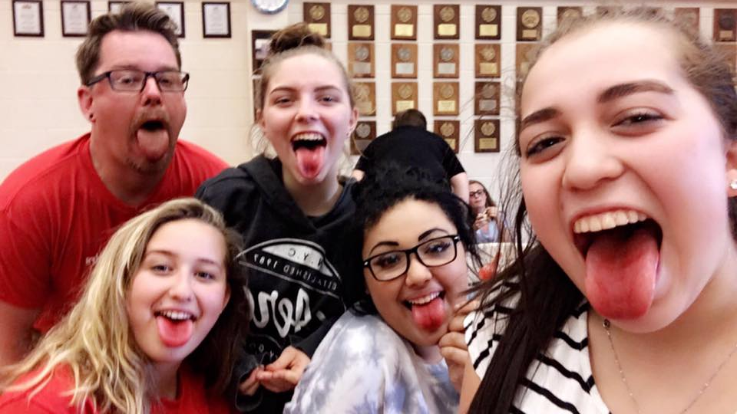
Choir Camp
Choir Camp allows new and veteran members of the choirs to work together to develop musical, leadership, and teamwork skills.
Gives students a chance to interact and make friends with other choir members they may not be able to see everyday.
Focuses on team-building, welcoming new singers, and finding our sound as a choir.
Guest Directors often will offer fun activities and fresh new ideas.
The “Escape Room” has become a favorite of our singers over the past few years.

Slide 7
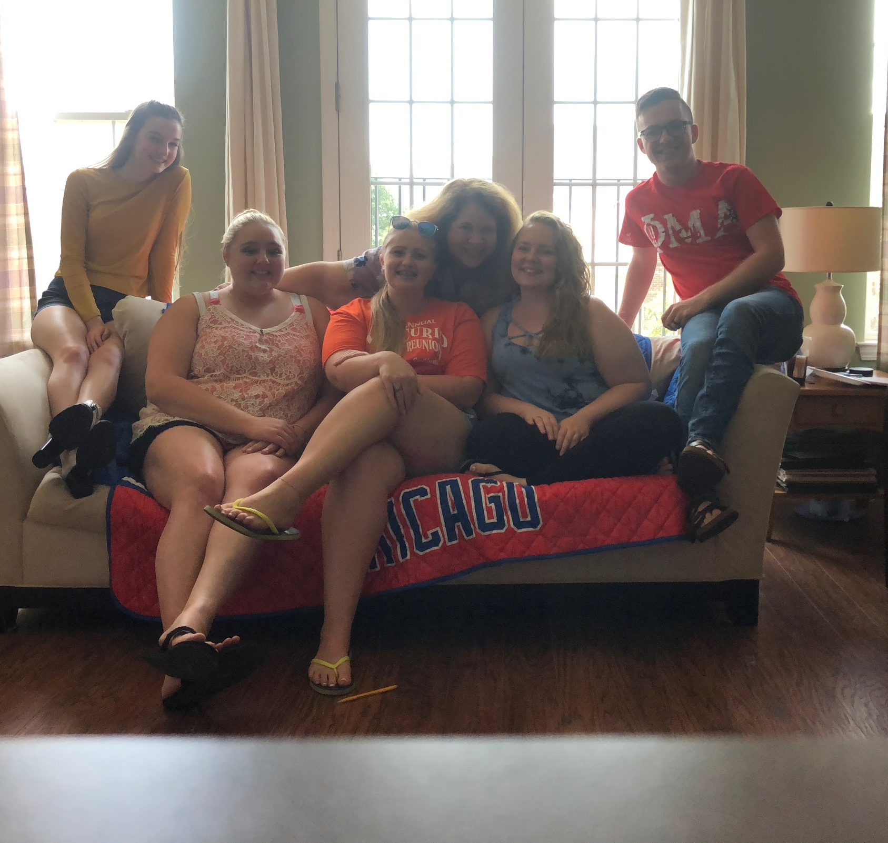
SMART Goal (Specific, Measurable, Attainable, Relevant, Timely)
To encourage and facilitate more student participation in extra activities and ensembles. This participation will enrich their choir experience and raise the level of performance of the Monroe Choir ensembles.
private lessons, community choirs, community theatre, musical theatre solo & ensemble, solo & ensemble, musical theatre intensive, a cappella festival, student led ensembles

Slide 8
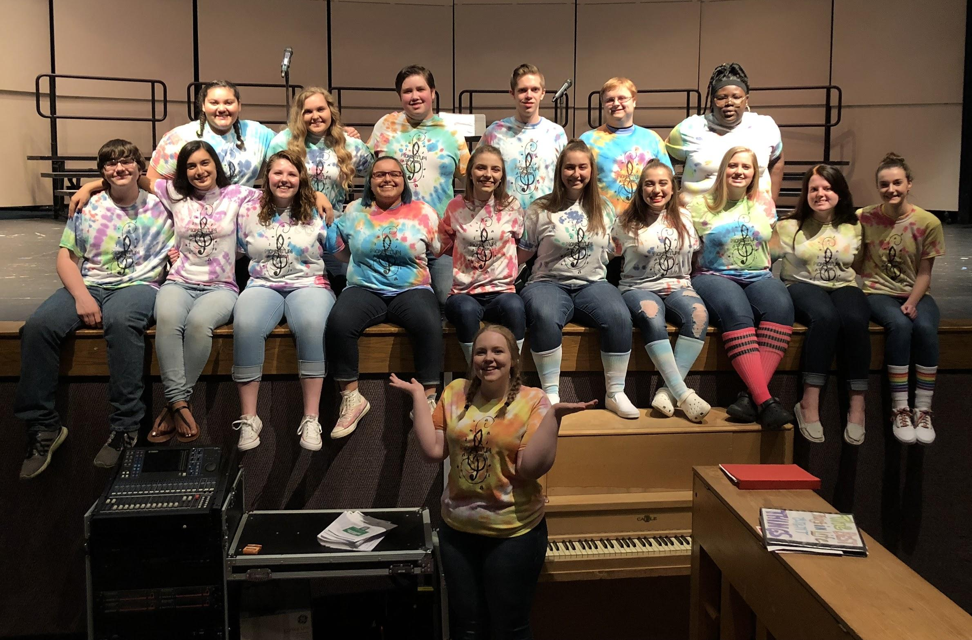
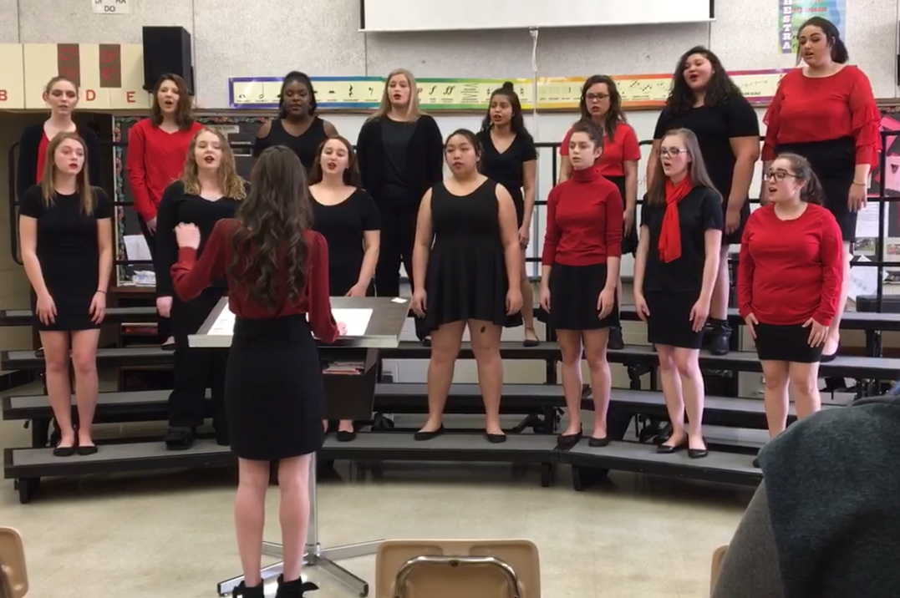
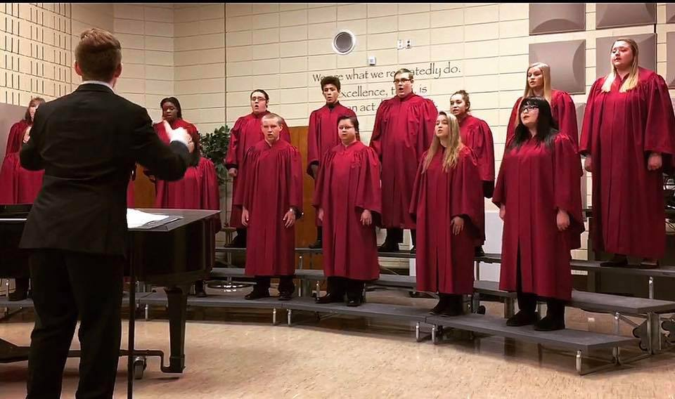
Student Led Groups
Since 2014, Monroe High School has had 4 student-directed ensembles.
Momentum (mixed, pop/choral)
Tonal Eclipse (mixed, a cappella)
TrebleMakers (treble, a cappella)
Infinite Illumination (mixed, pop)
Student led groups teach students important communication, leadership, and time management skills.
Student directors with an interest in Music Education get a jump-start learning about the career.
Student directed ensembles have the option to attend Solo and Ensemble festival, as well as A Cappella festival.
All Monroe student led ensembles have received ‘I’ ratings at district and state level festivals.

Slide 9
The Choir Keys to Success
Communication is Key
Plan Ahead
You Choose Your Attitude
Be Your Own Advocate
Strive for Excellence
Be Kind

Slide 10
