Slide 2
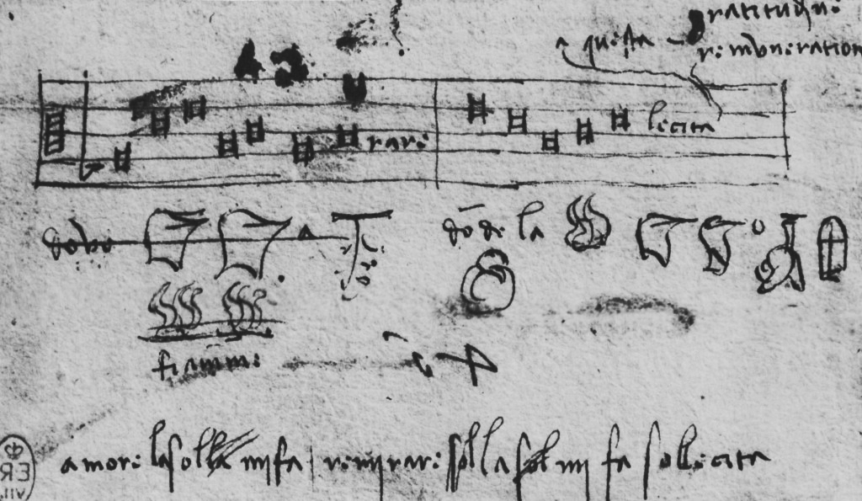
Innovation
A creative, sustainable response
to a challenge or problem.

Slide 3
The Foundation of Innovation
“…We got (sic) to find a way to make this, fit into the hole for this, using nothing but that.”
www.youtube.com/watch?v=C2YZnTL596Q

Slide 4
POETIC

Slide 5
PEOPLE
Thinking innovatively requires empathy for those we serve, imagining the world through multiple perspectives.

Slide 6
OPTIMISM
Thinking innovatively requires optimistic thinking, knowing that there is at least one breakthrough idea that will be a solution.

Slide 7
EXPERIMENTATION
Thinking innovatively requires experimentation, or a process of trial and error as we think through various solutions.

Slide 8
TENSION
Tension is your signal that progress is being made. Rather than avoiding tension, move into the storm.

Slide 9
IDEA
Thinking innovatively requires integrating parts of a problem toward a breakthrough innovative solution.

Slide 10
COLLABORATION
Thinking innovatively requires collaborative thinking, drawing from the skills and knowledge of others and not relying solely on oneself.

Slide 11
